Slide 1
PROCESS FLOW
BUYER
Request for supplies
Request for supplies
Request for supplies
VENDER-1
VENDER-2
VENDER-N
Quotes for the requests
BUYER
Approves the quote
VENDER-K

Slide 2
ROLES
BUYER
VENDORS

Slide 3
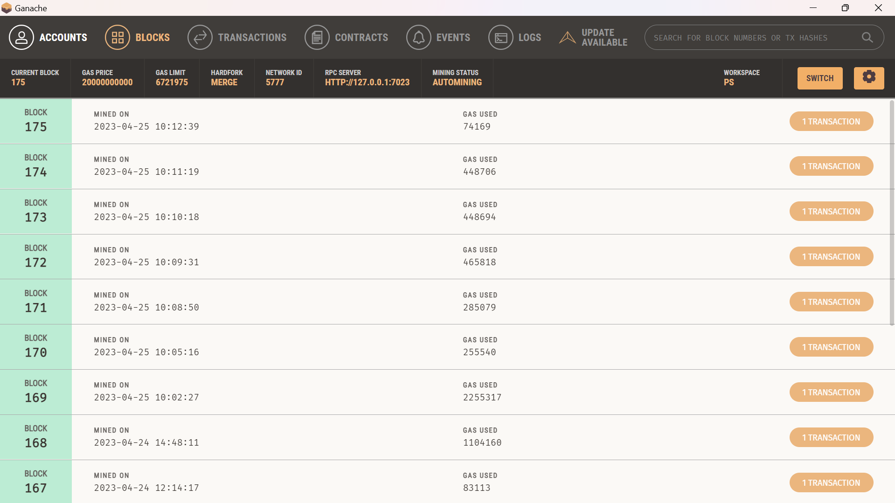
BLOCKS

Slide 4
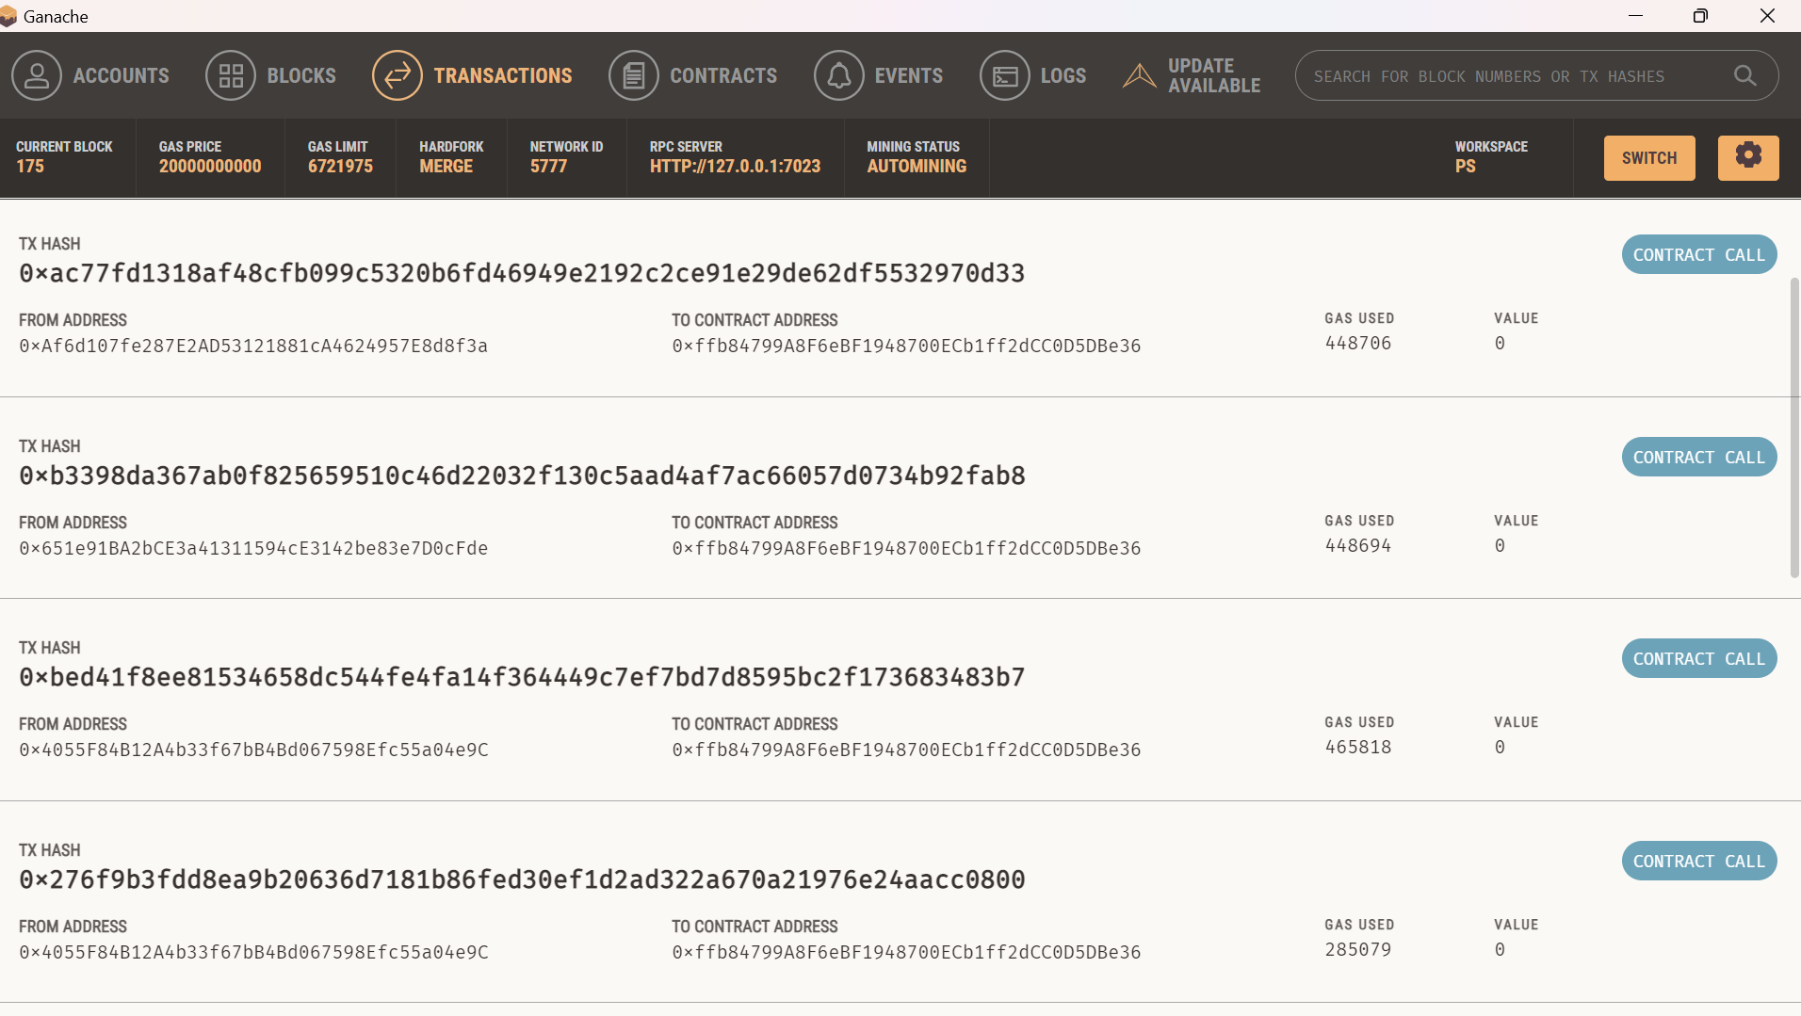
TRANSACTIONs

